Slide 1
E-Commerce Product Showcase
CAPSTONE PROJECT
Presented By:
Student Name - Bharath Ramanatha Hegde
College Name - Seshadripuram Degree College
Department - Bachelor of Computer Applications (BCA)

Slide 2
OUTLINE
Problem Statement (Should not include solution)
System Development Approach (Technology Used)
Algorithm & Deployment (Step by Step Procedure)
Result
Conclusion
Future Scope(Optional)
References

Slide 3
Problem Statement
Small businesses cannot afford complex e-commerce sites like Amazon or Flipkart.
They just need a basic online product showcase to display items with images, names, and prices.
From our code, we created a product grid (HTML + CSS) that looks neat and works on both desktop and mobile.
With JavaScript, customers can add items to the cart, update quantity, and see live total.
Our cart page allows removing items, clearing the cart, and checkout simulation — all handled on the frontend (no backend).
The design is lightweight, mobile-responsive, and user-friendly, so even non-technical shop owners can manage it.
Deployment on GitHub/Netlify makes it free and accessible anywhere, giving small businesses an online presence.

Slide 4
System Approach
I used HTML5 to build the basic structure of the site → product grid, navbar, and cart table.
CSS3 is used for styling: product cards, buttons, toast notification, and making the layout mobile-responsive.
JavaScript adds life to the project: add to cart, remove from cart, clear cart, checkout, and live grand total updates.
The design is clean and user-friendly so that even a small shop owner can easily use it.
The cart system is completely handled on the frontend (localStorage), so no backend is needed.
Files are kept modular:
The layout is responsive, so it looks good on desktops, tablets, and mobile phones without breaking.
Finally, the project is deployed on Netlify/GitHub so it is free, easy to access, and can be shared with anyone.
index.html → product showcase
style.css → all styling
script.js → add-to-cart logic
cart.html → cart page with total calculation

Slide 5
Algorithm & Deployment
Algorithm (Step-by-Step Flow)
Create Product Catalog → I listed 6 products in index.html with image, name, and price.
Frontend Design → Using HTML + CSS, I made a grid layout with product cards, buttons, and a clean responsive UI.
Add-to-Cart Feature → In script.js, when the button is clicked, the item is saved in localStorage and count is updated in navbar.
Cart Page → In cart.html, items are loaded from localStorage into a table with columns: Product, Price, Quantity, Total, Action.
Interactive Functions → JavaScript updates quantity, recalculates totals in real-time, and allows removing items or clearing the whole cart.
Validation → If cart is empty and user clicks Checkout or Clear, an error/warning is shown instead of success.
Responsive Testing → Checked layout on desktop, tablet, and mobile. Table scrolls properly on small screens and grid adapts to screen width.
Cross-browser Testing → Verified on Chrome and Edge to ensure compatibility.
Deployment
Project is modular (separate HTML, CSS, JS).
Uploaded code to GitHub repository.
Connected repo to Netlify for free hosting.
Now the site auto-updates whenever code is pushed to GitHub.

Slide 6
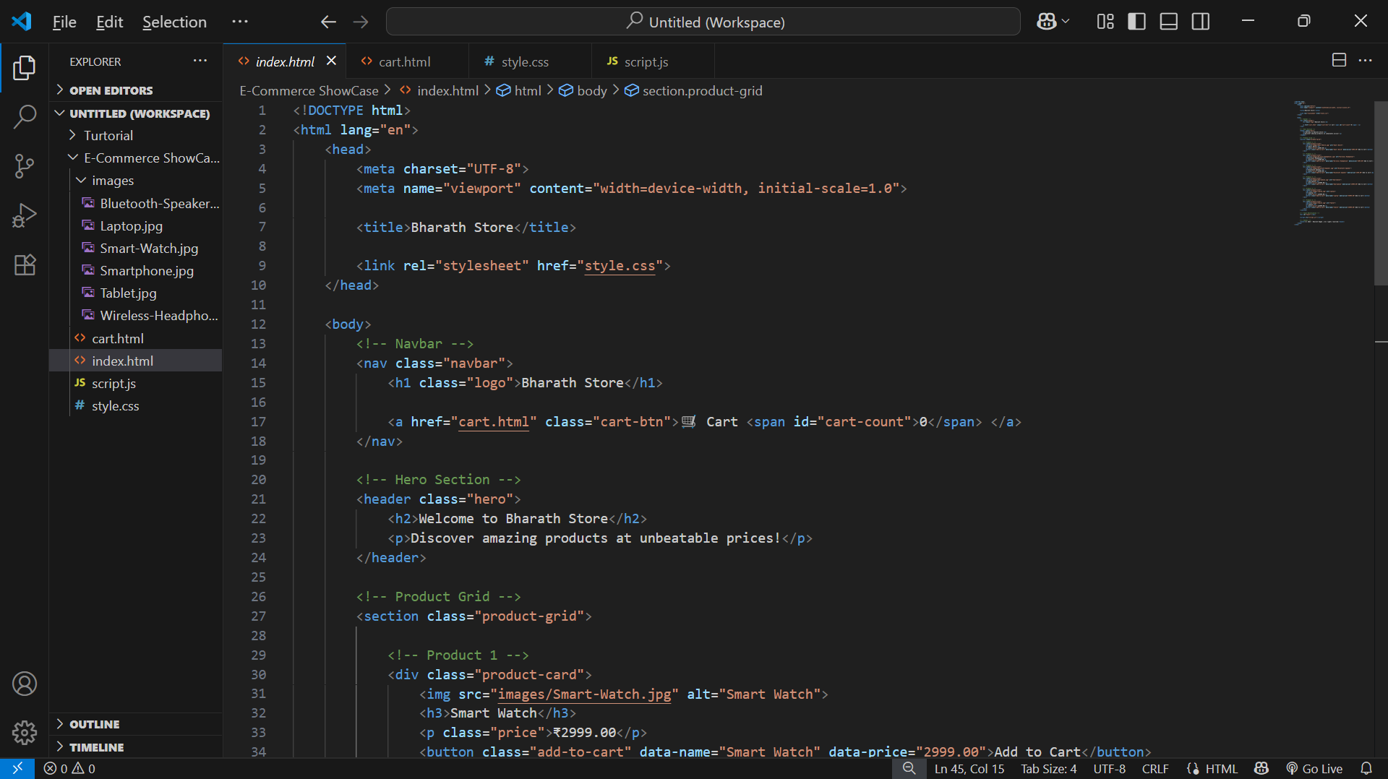
Result

Slide 7
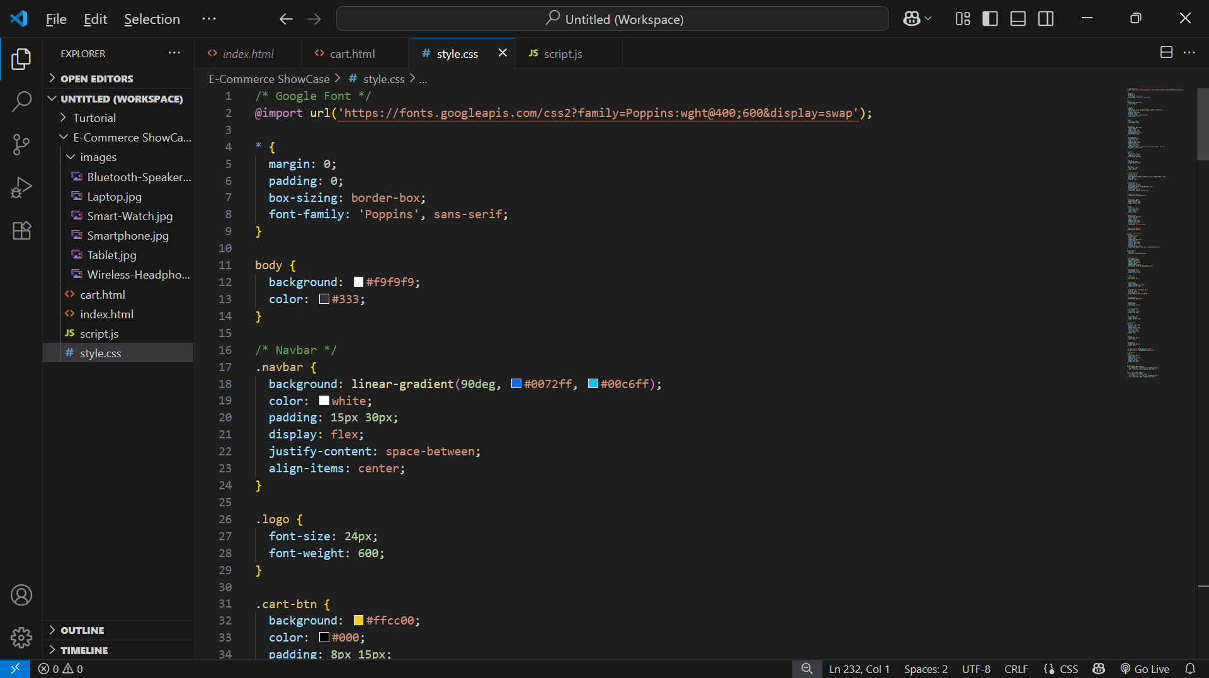
Result

Slide 8
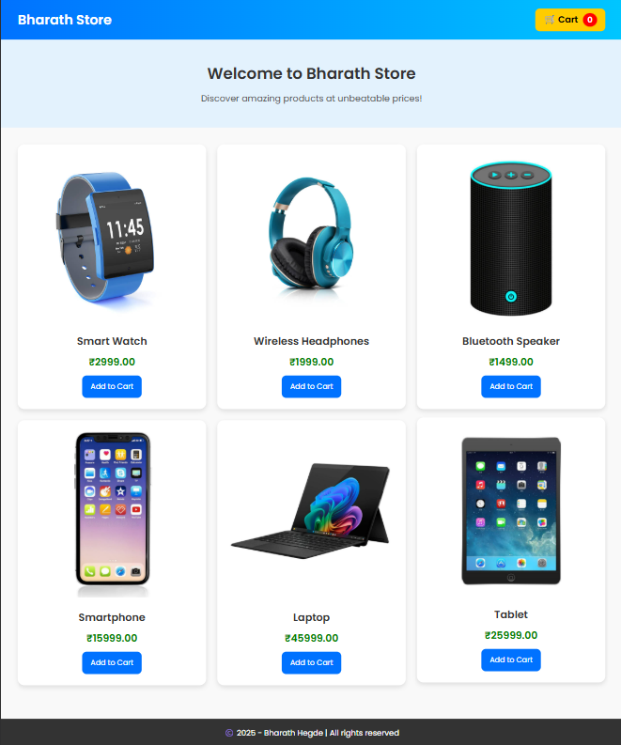
Result

Slide 9
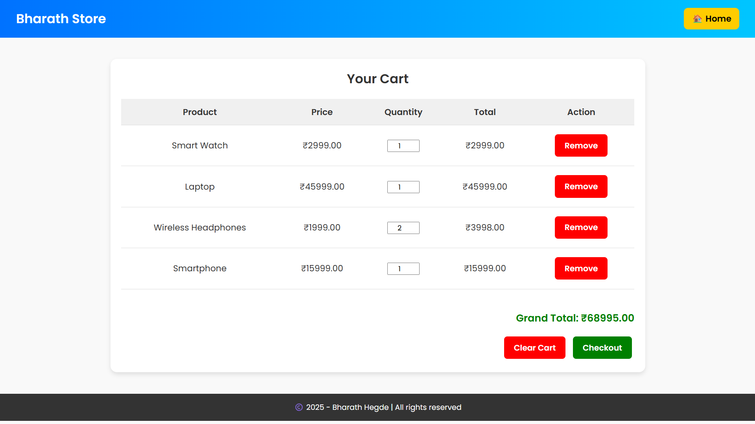
Result

Slide 10
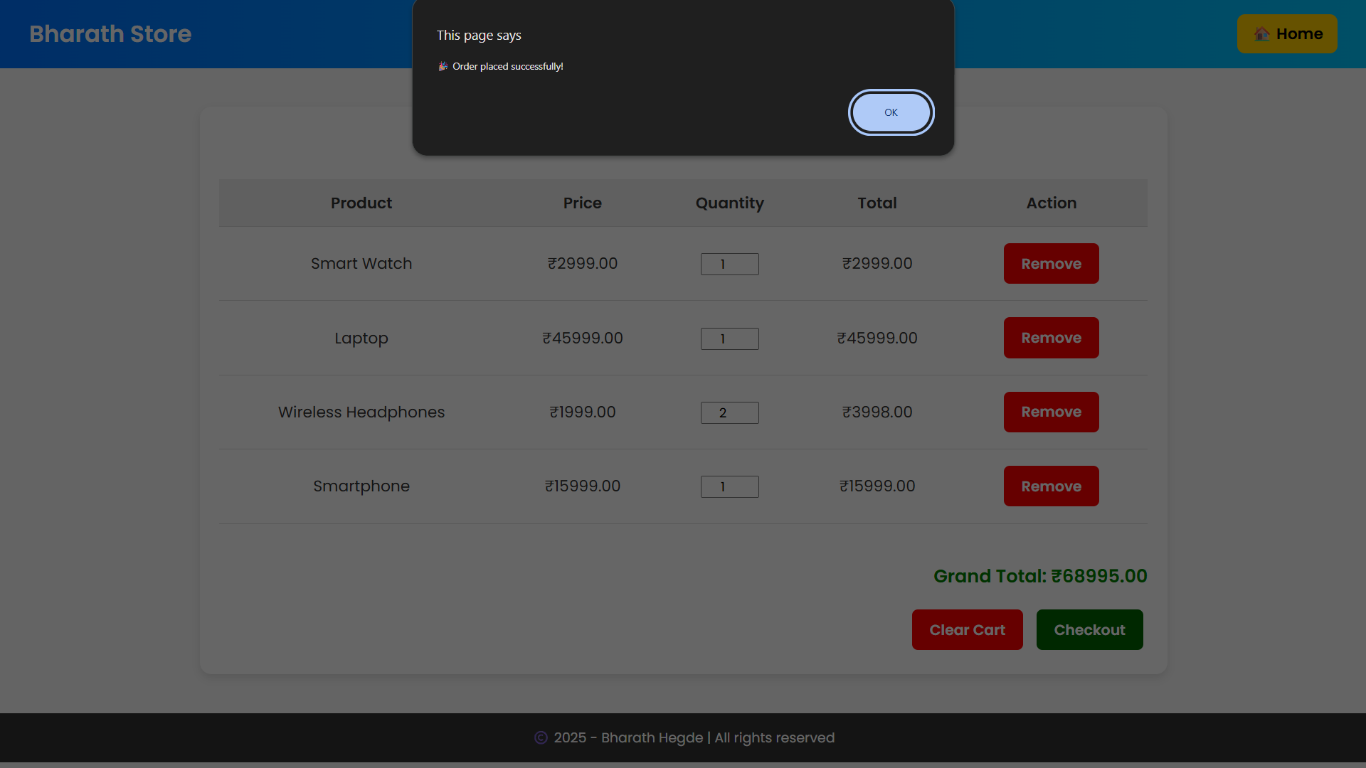
Result

Slide 11
GITHUB AND DEPLOYMNET LINK
Attach your Github Link : https://github.com/hd-bharath28/E-Commerce-Product-Showcase.git - coding files
Deployment link: https://hd-bharath28.github.io/E-Commerce-Product-Showcase/

Slide 12
Conclusion
This project gives small businesses a simple and cost-free way to show their products online.
Unlike big platforms, our solution is lightweight, easy to use, and doesn’t need a backend.
Using HTML, CSS, and JavaScript, I created a responsive product grid and a working cart system.
Customers can add, remove, and update products in real time, making the experience interactive.
The cart page calculates the grand total automatically, improving usability.
The website works well on mobile, tablet, and desktop, so it is accessible to everyone.
Finally, hosting on GitHub/Netlify makes it free and available anywhere, helping small shops build an online presence without extra cost.

Slide 13
Future scope(Optional)
Right now, my project is frontend only (HTML, CSS, JS, localStorage). In the future, I can connect it to a backend (Node.js, Express, MongoDB) to manage products and customer orders.
A secure payment gateway (Razorpay, PayPal, Stripe) can be added so customers can pay online safely.
An Admin Dashboard can be developed for shop owners to easily add, remove, or update products without touching code.
Use AI-based product recommendations to show related or popular items to customers.
Add user login and signup so customers can save their cart and order history.
Provide email/SMS notifications after checkout for better customer engagement.
Expand to a full multi-vendor marketplace where many small shops can upload their products.

Slide 14
References
I referred to online tutorials and documentation to learn how to structure webpages with HTML5, style them using CSS3, and add interactivity using JavaScript.
The MDN Web Docs (Mozilla Developer Network) and W3Schools were helpful for understanding basic tags, CSS properties, and JavaScript functions.
I explored sample GitHub projects like NanthiniMoha/TNSDC-FWD-DIGITAL_PORTFOLIO to understand how to organize files and design a clean layout.
I checked Bootstrap v5.3 documentation to learn about responsive design concepts (grid, cards, buttons), even though I finally used plain CSS.
I followed Netlify and GitHub guides for free project deployment and version control.
I also looked at general YouTube tutorials and coding blogs for implementing features like toast notifications, responsive tables, and localStorage cart functionality.

Slide 15
THANK YOU

